Slide 1
NC and CNC machines and Control Programming
Introduction to NC and CNC machines
CNC controls and RS274 programming

Slide 2
History of CNC
1949
US Air Force asks MIT to develop a "numerically controlled" machine.
1952
Prototype NC machine demonstrated (punched tape input)
1980-
CNC machines (computer used to link directly to controller)
1990-
DNC: external computer “drip feeds” control programmer to machine tool controller

Slide 3
Motivation and uses
To manufacture complex curved geometries in 2D or 3D was extremely expensive by mechanical means (which usually would require complex jigs to control the cutter motions)
Machining components with repeatable accuracy
Unmanned machining operations

Slide 4
Advantages of CNC
- Easier to program;
- Easy storage of existing programs;
- Easy to change a program
- Avoids human errors
- NC machines are safer to operate
- Complex geometry is produced as cheaply as simple ones
- Usually generates closer tolerances than manual machines

Slide 5
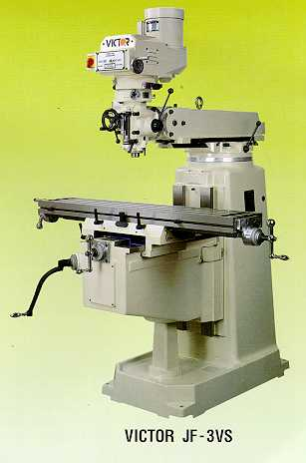
Conventional milling machines
Vertical milling machine

Slide 6
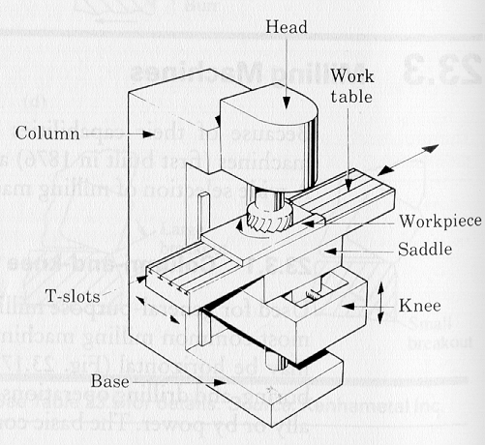
Conventional milling machines
Vertical Milling machine architecture

Slide 7
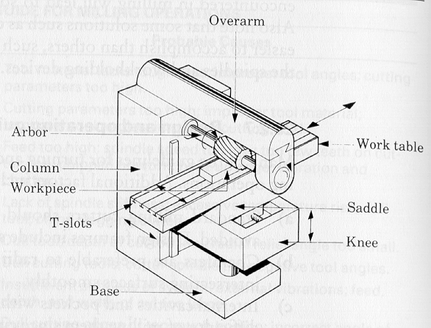
Conventional milling machines
Horizontal Milling machine architecture
How does the table move along X- Y- and Z- axes ?

Slide 8
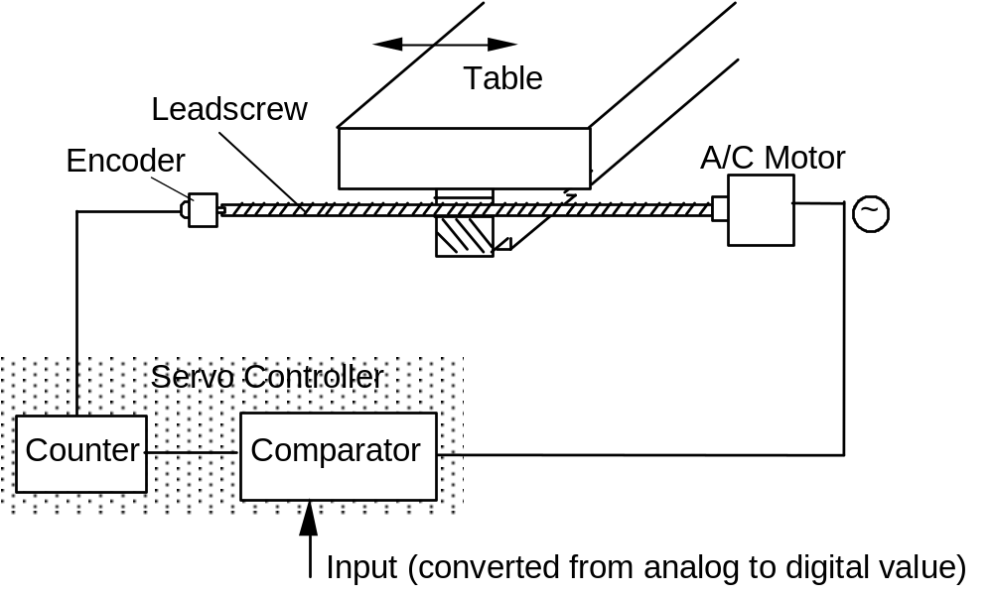
NC machines
Motion control is done by: servo-controlled motors

Slide 9
CNC terminology
BLU: basic length unit ➔
smallest programmable move of each axis.
Controller: (Machine Control Unit, MCU) ➔
Electronic and computerized interface between operator and m/c
Controller components:
1. Data Processing Unit (DPU)
2. Control-Loops Unit (CLU)

Slide 10
Controller components
Data Processing Unit:
Input device [RS-232 port/ Tape Reader/ Punched Tape Reader]
Data Reading Circuits and Parity Checking Circuits
Decoders to distribute data to the axes controllers.
Control Loops Unit:
Interpolator to supply machine-motion commands between data points
Position control loop hardware for each axis of motion

Slide 11
Types of CNC machines
Based on Motion Type:
Point-to-Point or Continuous path
Based on Control Loops:
Open loop or Closed loop
Based on Power Supply:
Electric or Hydraulic or Pneumatic
Based on Positioning System
Incremental or Absolute

Slide 12
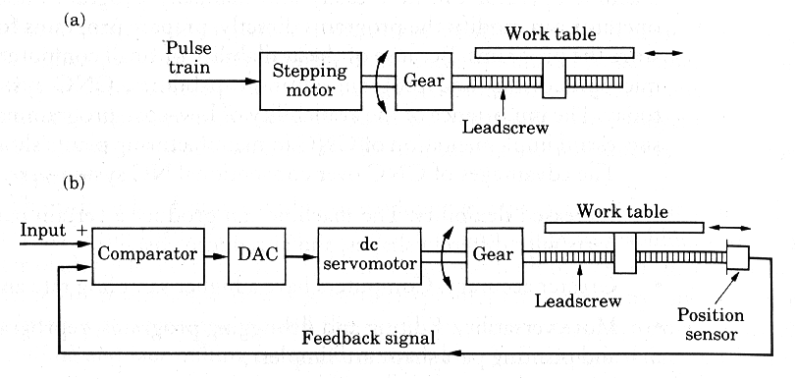
Open Loop vs. Closed Loop controls

Slide 13
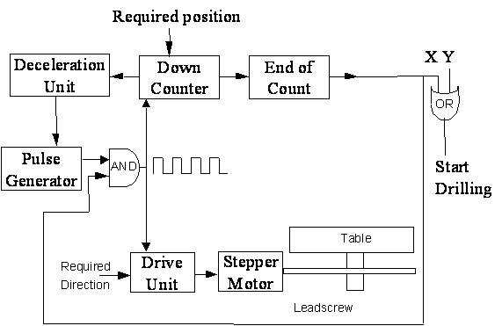
Open loop control of a Point-to-Point NC drilling machine
NOTE: this machine uses stepper motor control

Slide 14
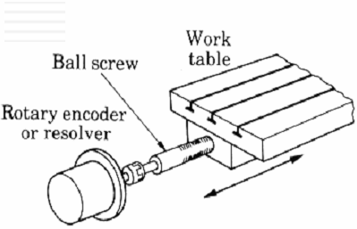
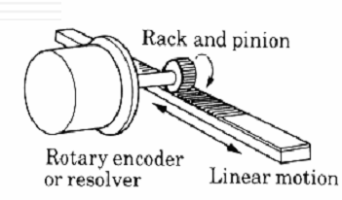
Components of Servo-motor controlled CNC
Motor
lead screw rotation
table moves
Motor speed control
feedback
position sensed by encoder
Two types of encoder configurations

Slide 15
Motion Control and feedback
Encoder outputs: electrical pulses (e.g. 500 pulses per revolution)
Rotation of the motor → linear motion of the table: by the leadscrew
The pitch of the leadscrew: horizontal distance between successive threads
One thread in a screw ➔ single start screw: Dist moved in 1 rev = pitch
Two threads in screw ➔ double start screw: Dist moved in 1 rev = 2* pitch

Slide 16
Example 1
A Stepping motor of 20 steps per revolution moves a machine table through a leadscrew of 0.2 mm pitch.
(a) What is the BLU of the system ?
(b) If the motor receives 2000 pulses per minute, what is the linear velocity in inch/min ?

Slide 17
Example 2
A DC servo-motor is coupled to a leadscrew (pitch 5mm) of a machine table. A digital encoder, which emits 500 pulses per revolution, is mounted on the leadscrew. If the motor rotates at 600 rpm, find
(a) The linear velocity of the table
(b) The BLU of the machine
(c) The frequency of pulses emitted by the encoder.

Slide 18
Manual NC programming
Part program: A computer program to specify
- Which tool should be loaded on the machine spindle;
- What are the cutting conditions (speed, feed, coolant ON/OFF etc)
- The start point and end point of a motion segment
- how to move the tool with respect to the machine.
Standard Part programming language: RS 274-D (Gerber, GN-code)

Slide 19
History of CNC
The RS274-D is a word address format
Each line of program == 1 block
Each block is composed of several instructions, or (words)
Sequence and format of words:
N3 G2 X+1.4 Y+1.4 Z+1.4 I1.4 J1.4 K1.4 F3.2 S4 T4 M2
sequence no
destination coordinates
dist to center of circle
tool
feed rate
spindle speed
preparatory function
miscellaneous function

Slide 20
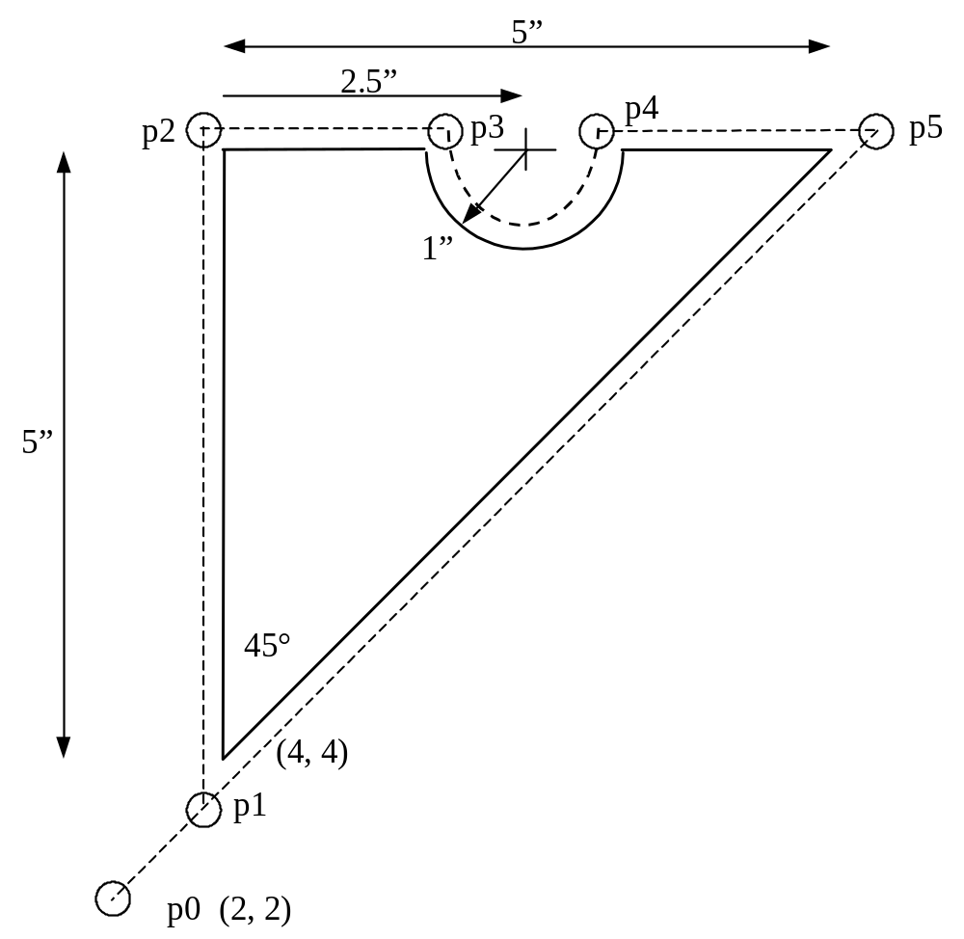
Manual Part Programming Example
Tool size = 0.25 inch,
Feed rate = 6 inch per minute,
Cutting speed = 300 rpm,
Tool start position: 2.0, 2.0
Programming in inches
Motion of tool:
p0 → p1 → p2 → p3 → p4 → p5 → p1 → p0

Slide 21
1. Set up the programming parameters
Programming in inches
Use absolute coordinates
Feed in ipm
N010 G70 G90 G94 G97 M04
Spindle speed in rpm
Spindle CCW

Slide 22
2. Set up the machining conditions
Machine moves in XY-plane
Use full-circle interpolation
Feed rate
Spindle speed
N020 G17 G75 F6.0 S300 T1001 M08
Tool no.
Flood coolant ON

Slide 23
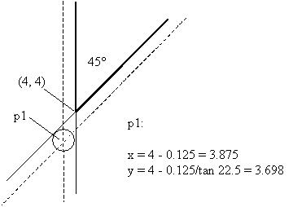
3. Move tool from p0 to p1 in straight line
Linear interpolation
target coordinates
N030 G01 X3.875 Y3.698

Slide 24
4. Cut profile from p1 to p2
Linear interpolation
target coordinates
N040 G01 X3.875 Y9.125
or
N040 G01 Y9.125
X-coordinate does not change ➔ no need to program it

Slide 25
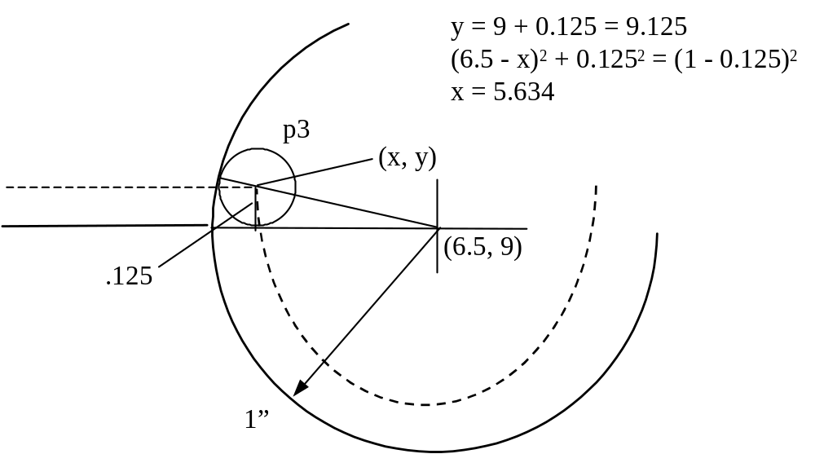
5. Cut profile from p2 to p3
Linear interpolation
target coordinates
N050 G01 X5.634 Y9.125

Slide 26
6. Cut along circle from p3 to p4
circular interpolation, CCW motion
target coordinates
N060 G03 X7.366 Y9.125 I6.5 J9.0
coordinates of center of circle

Slide 27
7. Cut from p4 to p5
Linear interpolation
target coordinates (Y is unchanged)
N070 G01 X9.302

Slide 28
8. Cut from p5 to p1
Linear interpolation
target coordinates (see step 3)
N080 G01 X3.875 Y3.698

Slide 29
9. Return to home position, stop program
Linear interpolation
target coordinates (see step 3)
N090 G01 X2.0 Y2.0 M30
end of data
N100 M00
program stop

Slide 30
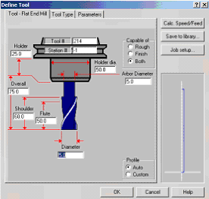
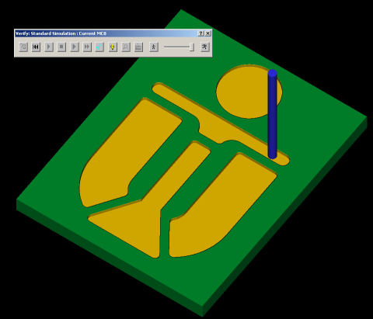
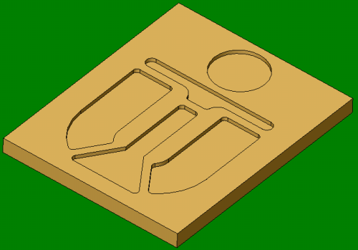
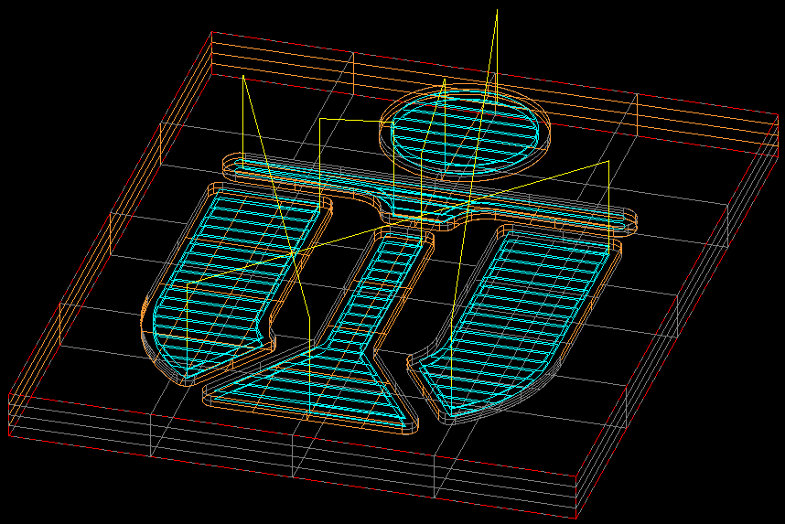
Automatic Part Programming
Software programs can automatic generation of CNC data
Define Tool
CNC data
Make 3D model
Simulate
cutting

Slide 31
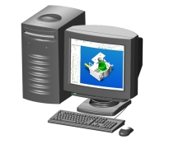
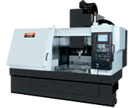
Automatic part programming and DNC
Very complex part shapes ➔ very large NC program
NC controller memory may not handle HUGE part program
computer feeds few blocks of
NC program to controller
When almost all blocks executed,
controller requests more blocks

Slide 32
Summary
CNC machines allow precise and repeatable control in machining
CNC lathes, Milling machines, etc. are all controlled by NC programs
NC programs can be generated manually, automatically
Additional references: RS274D code descriptions

